Slide 1
Biodiversity, Ecosystems Services, and CI: Potential, Challenges and Opportunities
Konkuk University
9 October 2012
Karpjoo Jeong, Konkuk U
Eun-Shik Kim, Kookmin U
Reed Beaman, U Florida
Peter Arzberger, UC San Diego

Slide 2
Welcome and Introductions
Name
Institution
Why are you attending?

Slide 3
Multiple Paths to This Workshop
Personal Professional
Opportunity
Technology Advances
Community Awareness
Funding
Dimensions of Biodiversity
Digitization of Collections
Impact
Community Activities
AP-BON: Asia Pacific Biodiversity Observation Network
ILTER: International Long-Term Ecological Research
ACB: ASEAN Center for Biodiversity
CIFOR: Center for International Forestry Research
Prior Work
SEAIP Workshop
December 2011, Taiwan:
Host NCHC
Linked data
Natural products chemistry
Spatial data and analysis
Biodiversity in Southeast Asia: Defining CI in Support of Studies in Ultramafic Ecosystems,
April 2012, Melbourne PRAGMA 22:
Host Monash
Identified initial project
Notes:
Reed – field work in Kinabalu; time at NSF – leading CI workshop for Biodiversity
Eun-Shik – leader in AP region in LTER, part of AP BON
Karpjoo – hosting PRAGMA 23
Peter – GBIF experience, ILTER experience, PRAGMA, NSF

Slide 4
Goals for Workshop
Exchange information about technologies and research opportunities at interface of biodiversity, ecosystems services, and genetics
Outline some projects of mutual interest
Linking together other projects
Build interaction between organizations
Determine future activities
For example use PRAGMA 24, March 2013, Bangkok

Slide 5
PRAGMA Community of Practice in the Asia Pacific Region
Biodiversity, Ecosystems Services, and CI: Potential, Challenges and Opportunities
9 October 2012

Slide 6
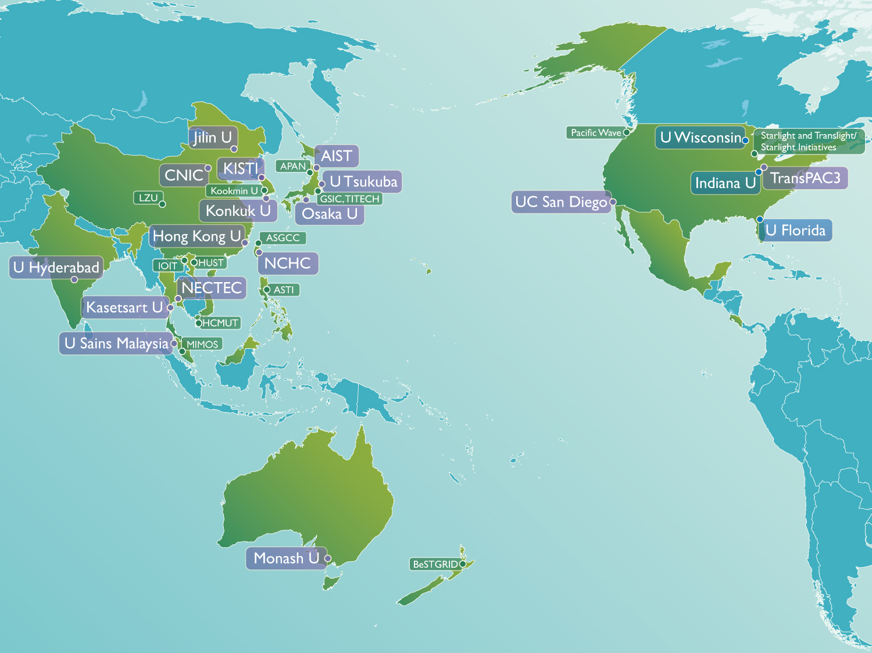
PRAGMA A Practical Collaboration Framework
Build and Sustain
Collaborations
Advance & Improve
Cyberinfrastructure
Through
Applications

Slide 7

PRAGMA’s Overarching Themes to Enable Team Science
Construct international scientific expeditions
Develop and improve a grassroots, international cyberinfrastructure
Infuse new ideas through students and strategic partners
Build and enhance the essential people-to-people trust fabric
NSF Renewed PRAGMA (US) for Five More Years
Biodiversity Expedition Funded
Notes:
Building and enhancing the essential people-to-people trust fabric and organization developed through regular face-to-face meetings, a core component of PRAGMA’s success;
Developing and improving a grassroots, international cyberinfrastructure for testing, computer science insight, and application support through sharing resources, expertise, and software;
Constructing international “scientific expeditions” to advance specific scientific needs while developing and testing the underlying technologies that are needed to create usable, international-scale, cyber environments through forging teams of domain scientists and cyberinfrastructure researchers;
Infusing new ideas from developing new researchers with experience in cross-border science and engaging strategic partners.

Slide 8
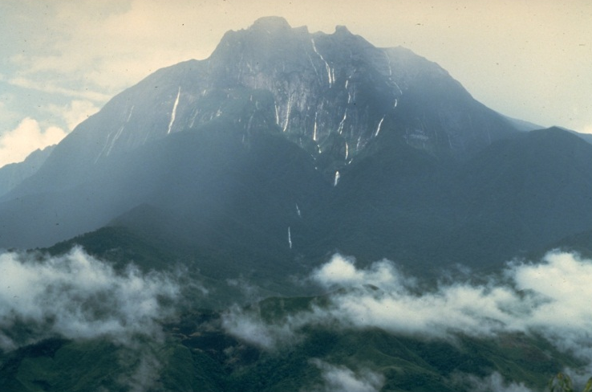
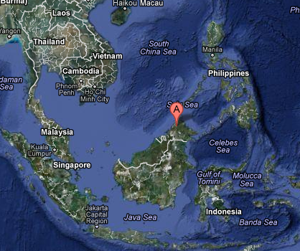
Understanding Adaptation in Extreme Environments: A Scientific Virtual Expedition
First Step: 6 months
Presentation Today
Demo Today
Longer Term:
Private networks
Satellite and Sensors
Build people network
Participants
Reed Beaman (UF), Beth Plale, Umashanthi Pavalanathan; Yuan Luo (IU), Shashir Shamshir (UTM, MY), Aimee Stewart (KU), Antony Van der Ent (UQ, AU), Yoshio Tanaka (AIST, JP), Andreina Weischselbaumer (UF)
Advancing Science and Technology
Data discovery and sharing
Scaling biology research along with technology
Predicting species distribution
Focus: Mt Kinabalu
Notes:
what are the specific biotic, abiotic, and evolutionary factors that affect patterns of diversity, distribution and endemism in ultramafic regions?
Why SEA

Slide 9
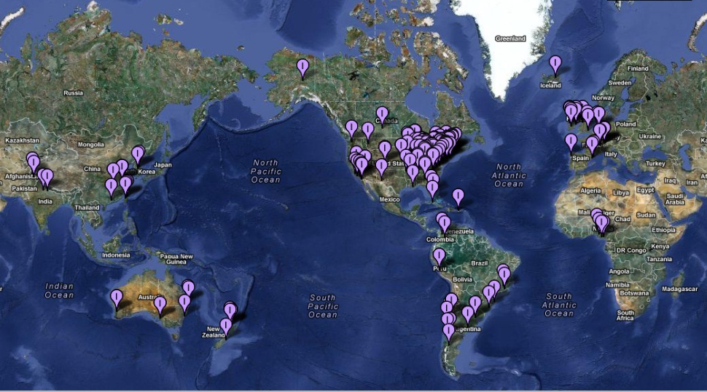
GLEON and PRAGMA Partnership
Global Lakes Ecological
Observatory Network
Scientific Expedition 2012
Predicting Lake Eutrophication
Tracking use of shared data (provenance) to promote data sharing
Differentiate algal communities
Provide insights into the drivers of phytoplankton dynamics
Participants
Paul Hanson (UW), Beth Plale (IU), GLEON Working Group – US, NZ, Korea, China, Ireland, England
Network of People, Sensors, Data
Launched as a PRAGMA Expedition in 2003
Grown to more than 300 researchers
Research: data across >40 lakes
Active Graduate Student Assoc.
Notes:
Tracking use of shared data (provenance) to promote data sharing among members; and to provide use statistics to funding agencies
Differentiate algal communities; provide insights into the drivers of phytoplankton dynamics and how driver-response relationships change under changing environmental conditions

Slide 10
Grass-roots International CI
Components
Challenge: Integration
and a Plan for Trust Envelop
VM Migration, images and clusters
Overlay network experiments
Data cloud
Observing systems
Importance of
Trust Envelop
Provide an infrastructure that initially limits access to data
Traverse firewalls and simplify network re-configuration of application VMs
Using the Expeditions to Drive
The Development of a
TRUST ENVELOPE
Notes:
Provide an infrastructure that initially limits access to data
Traverse firewalls and simplify network re-configuration of application VMs

Slide 11
Working Groups and Expeditions
Scientific Understanding
Community Tools
Biodiversity Expedition
Data Discovery
Virtualization
Overlay Networks
Earth Observing &
Sensors
PRAGMA Cloud
VM/VC Experiments
Overlay Networks
Data Provenance
Resources
i
Interface to Integrate
Earth Observing
GEO
Sensor Networks
Remote Control
Network Applications
Telescience
Biosciences
Avian Flu Grid

Slide 12
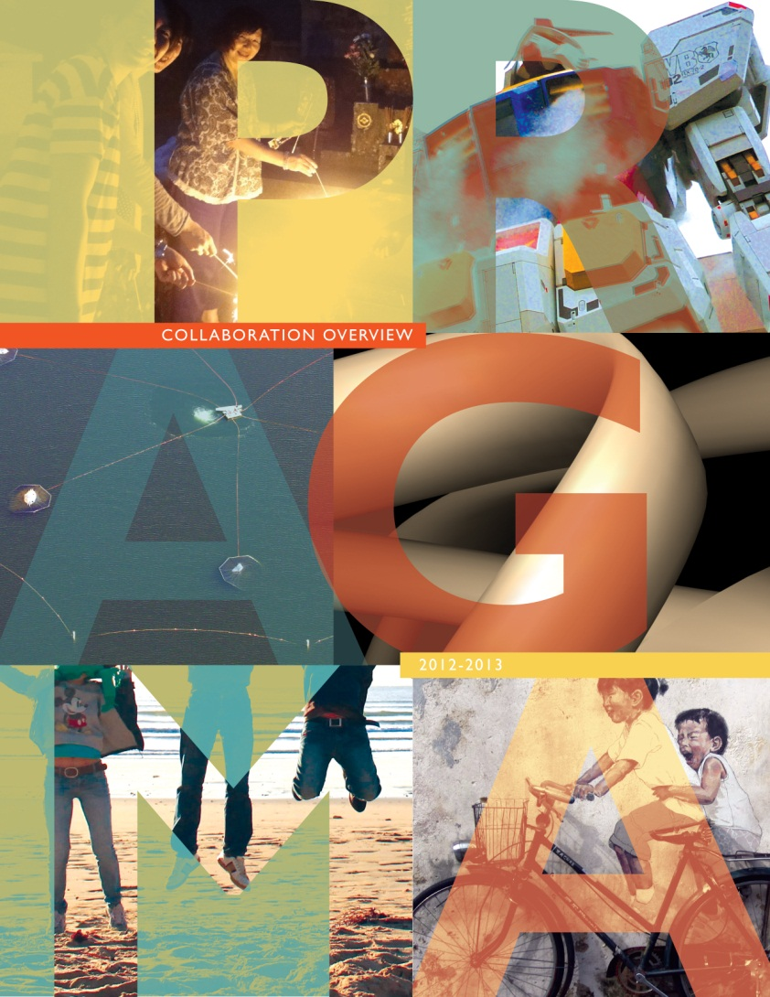
Progress through Active Participation
Look forward to strategic discussion about developing virtual expeditions
Eager to form partnerships
PRAGMA is an Asia Pacific community of practice, with a focus on biodiversity

Slide 13
Agenda - Morning
Biodiversity and Ecosystems Services
Biodiversity on ultramafic outcrops: Reed Beaman
Molecular biodiversity of Plant: Dong-Jin Kim
Group Photo and Break
ILTER-EAP, AP-BON and GRENE, Environmental R&D in Korea
Environmental R&D in Korea: Young Ja Kim
ILTER-EAP and AP-BON: Eun-Shik Kim
AP-BON and GREENE on Environmental Informatics: Motimo Ito
A PRAGMA Expedition: Reed Beaman , Aimee Stewart,
Uma Pavalanathan, Shahir Shamshir

Slide 14
Agenda - Afternoon
Cyberinfrastructure and Information Technology
Linked Open Data of Ecology: Chau-Chin Lin
iDigBio CI: 1st Year Progress: Jose Fortes
GEO Grid: Yoshio Tanaka
Redeployable Sensors Networks: Sameer Tilak
Panel Discussion
Opportunities
Plans
Student Workshop 3 pm
UBITA on Konkuk Campus
Reception at 6 pm
Classic 500 Grand Ballroom
PRAGMA 23 10 – 11 October 2012
Main Hall Classic 500
8:30 am start

Slide 15
Thanks
Local Host
Karpjoo Jeong
Eui Joon Kim
Organizers
Eun-Shik Kim
Karpjoo Jeong
Reed Beaman
Presenters
Participants
Thank you for your active participation

Slide 17
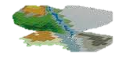

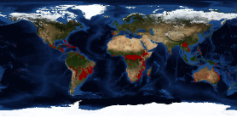

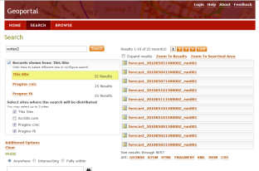
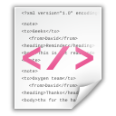
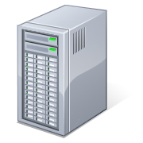
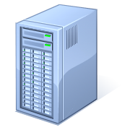
PRAGMA Biodiversity - LifeMapper Experiment
Mount Kinabalu specimen
data storage
(3)
Predicted Habitat
(1)
(2)
LifeMapper WebService at
UKansas
(4)
(5)
GeoPortal at UTM
Metadata
A script queries GeoPortal instance at UTM (Malaysia )to retrieve raster data
Retrieves raster data from stored dataset
Submit dataset to LifeMapper as occurrences/experiments
Prepare occurrence dataset
Post occurrence set
Post experiment
LifeMapper outputs prediction result as metadata (EML)
Catalogs LifeMapper predicted output metadata in GeoPortal at IU (US)
GeoPortal at IU
PRAGMA node
Graduate students key to this
Scientific Expedition
Source: Uma Pavalanthan
Notes:
What is Geo Portal? http://www.esri.com/software/arcgis/geoportal/index.html
ESRI GeoPortal is an open source metadata server that enables discovery and use of geospatial resources.
GeoPortal enables organizations to manage and publish metadata about their geospatial resources and let their users to discover and connect to those resources
What is LifeMapper? http://lifemapper.org/
At its core, LifeMapper consists of two main components:
First, An archive of species occurrence data, current and predicted climate and environmental data, and modeled habitat maps created from them
And second, a set of tools, published as webservices, for researchers to use with LifeMapper’s data, or their own, to study biodiversity of single or multiple species
What is metadata?
Refer next slide
About this experiment:
Metadata describing Mount Kinabalu raster data will be catalogued in a Geo Portal at Universiti Teknologi Malaysia (UTM)
A script running from an Indiana University(IU) PRAGMA node will query this catalog and retrieve specimen data
Specimen data will be passed to LifeMapper webservice running at University of Kansas
LifeMapper will output predicted habited and metadata describing it
The script will catalog this metadata in a GeoPortal instance running at IU, so that users can search the catalog and retrieve the predicted habited via LifeMapper

Slide 18
Opportunity: Strategic Partnership AP-BON and PRAGMA
Complementary Approaches
Mutual Benefits
Initial Steps
Invitation to Participate in Workshop on Biodiversity, Ecosystems Services, and CI
9 October 2012, Seoul
Participate in PRAGMA and working activities
PRAGMA 22: 10 – 11 October, 2012, Seoul
PRAGMA 23: March 2013, Bangkok
Identify Projects
Work through partnerships
No central funding
Complementary strengths
Leverage existing people networks
Commitment to training
Existing Shared Partners
AIST, TFRI, Kookmin
Notes:
From the Directorate narrative (http://www.nsf.gov/bio/budget/FY13/fy13.jsp):
BIO’s FY 2013 Request prioritizes contributions to the OneNSF Framework through support for innovative, interdisciplinary activities including Innovation Corps (I-Corps), INSPIRE, Science Engineering and Education for Sustainability (SEES), Cyberinfrastructure Framework for 21st Century Science and Engineering (CIF21), Expeditions in Education (E2), and Cyber-enabled Materials and Manufacturing and Smart Systems (CEMMSS). BIO also focuses investments on research to address the five Grand Challenges in Biology: synthesizing life-like systems; understanding the brain; predicting organisms’ characteristics from their DNA sequences; elucidating interactions between the earth, its climate and its biosphere; and understanding biological diversity (2010 National Research Council report, “Research at the Intersection of the Physical and Life Sciences”). In addition, BIO’s enhanced support for Research at the Interface of Biological and Mathematical and Physical Sciences and Engineering (BioMaPS) advances the knowledge frontier and bolsters the foundation of the OneNSF Framework.
It does, however, hit those areas I mentioned.
http://www.nsf.gov/pubs/2012/nsf12019/nsf12019.jsp
But also see (to which you are a signatory):
http://www.nsf.gov/pubs/2011/nsf11022/nsf11022.jsp
Dear Colleague Letter: Cyberinfrastructure in Support of Biological Sciences
Directorate for Biological Sciences Office of Cyberinfrastructure Offices of the Assistant Directors
November 22, 2011
The relationship between transformative scientific discovery and technological advance is an iterative, symbiotic one. The Directorate for Biological Sciences and the Office of Cyberinfrastructure would like to call attention to a recent, cross-foundation solicitation that provides a unique opportunity for members of the biological (and collaborating) sciences to become engaged in advancing an innovative and sustainable cyberinfrastructure in support of biological sciences. The Software Infrastructure for Sustained Innovation (SI2) (http://www.nsf.gov/funding/pgm_summ.jsp?pims_id=503489&org=NSF&sel_org=XCUT&from=fund) program takes a multi-dimensional approach to the development and provisioning of scientific software. The SI2 program has recently announced a competition that includes Conceptualization Awards, which are planning awards aimed at organizing an interdisciplinary community to examine and define their software requirements and challenges.
Numerous Dear Colleague Letters, research initiatives, and programs offered through the BIO Directorate, have drawn attention to significant areas of research where potential grand-challenge problems can be identified, including, but not limited to:
environmental research at macro scales;
predicting phenotypes from genotypes;
characterizing and understanding dimensions of biodiversity on the planet;
understanding complexity in biological systems; and
research in science, engineering, and education for sustainability.
When considering the constraints facing such emerging topics, it is possible to identify cyberinfrastructure challenges which, if addressed, could enable one or more areas to make significant advances. These include overcoming limits to data storage and transport, achieving high-throughput performance in critical analytic workflows, extracting complex data from multi-media source, multi-scale modeling and analysis. The past and current technological and research investments made by BIO in areas of data acquisition (National Ecological Observatory Network (NEON), Protein Data Bank (PDB), Plant Genome, Assembling the Tree of Life (ATOL), Long-term Ecological Research (LTER)), software tools (Advances in Biological Informatics (ABI), SI2), and collaborative science (BIO synthesis centers, Research Coordination Networks) present a fertile assortment of resources that could be leveraged to achieve new levels of technical capability to respond to grand challenge research questions.
BIO encourages members of its research and informatics community to consider this opportunity, either by participating directly in the submission of conceptualization proposals, or by responding to invitations to participate in projects that may be funded through this program. BIO is especially interested in conceptualization proposals that focus on high priority research problems and that will significantly leverage existing investments in ways that transform the infrastructure in support of BIO and BIO-related research. OCI is interested in providing a comprehensive, shared software environment as part of an overall coordinated cyberinfrastructure and encourages interdisciplinary research to provide better infrastructure.
Sincerely,
John Wingfield Assistant Director for Biological Sciences National Science Foundation
Alan Blatecky Director for Office of Cyberinfrastructure National Science Foundation
Contact information of program officers: * Peter McCartney, BIO/DBI, pmccartn@nsf.gov * Anne Maglia, BIO/DBI, amaglia@nsf.gov * Julie Dickerson, BIO/DBI, jdickers@nsf.gov * Gabrielle Allen, OD/OCI, gallen@nsf.gov
Software Infrastructure for Sustained Innovation (SI2) website: http://www.nsf.gov/funding/pgm_summ.jsp?pims_id=503489&org=NSF&sel_org=XCUT&from=fund
Dear Colleague Letter for the Science, Engineering and Education for Sustainability (SEES) NSF-Wide Investment Area
Achieving a sustainable human future in the face of both gradual and abrupt environmental change is one of the most significant challenges facing humanity. NSF will contribute to addressing this challenge by supporting the science and engineering research needed to understand and overcome the barriers to sustainable human well-being. In response to this global challenge, all eleven NSF Directorates and Offices have joined together to support Science, Engineering, and Education for Sustainability (SEES). The purpose of this DCL is to explain the scope of the SEES investment area, alert the community to activities that are being planned for the near term, and point to sources of additional information about future SEES plans.
Through SEES, NSF seeks to enable the discoveries needed to inform actions that lead to environmental, energy and societal sustainability. SEES will include the conceptual, theoretical, empirical, and computational research needed to further develop the basic science, engineering, education, and policy knowledge base relevant to sustainability. Additionally, it will support projects at multiple scales, from the individual to the system level, and will stimulate innovations in education and learning research and practice.
SEES is expected to be a multi-year effort that will address challenges in climate and energy research and education using a systems-based approach to understanding, predicting, and reacting to change in the linked natural, social, and built environment. In 2010, initial efforts focused on a suite of research and education programs at the intersection of climate and environment, with specific attention to incorporating human dimensions. Solicitations were released that addressed ocean acidification, water sustainability and climate, dimensions of biodiversity, earth systems modeling, and climate change education. Plans are to continue these competitions under the SEES portfolio. Future efforts will support research and education that builds connections between current projects, creates new nodes of activity, engages the public, and develops the personnel needed to understand the complexity of sustainability issues.
In FY 2011, NSF plans to encourage interdisciplinary research and education on energy sustainability, with a particular emphasis on the socioeconomic and environmental implications. Potential areas of emphases include the development of sustainable energy technologies, development of techniques for effective and efficient use of water resources, and research in transportation technology. A continued focus will be placed on creating the necessary workforce to address sustainability challenges and connecting elements of the SEES portfolio. Specific efforts will support postdoctoral researchers and early career scientists at the interfaces between social sciences and other science and engineering disciplines.
The SEES Portfolio will support research and education projects that span all eleven NSF Directorates and Offices, including:
research at the energy-environment-society nexus
novel energy production, harvesting, storage, transmission, and distribution technologies, and their intelligent control that minimizes environmental impact and corresponding adoption, socioeconomic, and policy issues
innovative computational science and engineering methods and systems for monitoring, understanding and optimizing life-cycle energy costs and carbon footprints of natural, social and built systems (including IT systems themselves)
data analysis, modeling, simulation, visualization, and intelligent decision-making facilitated by advanced computation to understand impacts of climate change and to analyze mitigation strategies
study of societal factors such as vulnerability and resilience, and sensitivity to regional change
short and long term research enabled by a new generation of experimental and observational networks
support for interdisciplinary education/learning science research, development, and professional capacity-building related to sustainability science and engineering
creation of research and education partnerships around forefront developments in sustainability science and engineering, both nationally and internationally
development of the workforce required to understand the complexities of environmental, energy, and societal sustainability
engaging the public to understand issues in sustainability and energy
development of the cyberinfrastructure and research instrumentation needed to enable sustainability science and engineering
support of the physical, cyber, and human infrastructure necessary to achieve SEES goals
Researchers who are interested in SEES-related topics are encouraged to consider the following near term activities, as well as periodically check the SEES web page (http://www.nsf.gov/sees) for specific guidance on future research funding opportunities:
The Dynamics of Coupled Natural and Human Systems (CNH) program is encouraging submission of projects related to SEES themes for its FY 2011 competition (NSF 10-612). CNH is jointly managed by the Biological Sciences; Geosciences; and Social, Behavioral, and Economic Sciences, while other NSF units (including the Directorate for Engineering, the Directorate for Education and Human Resources, the Office of International Science and Engineering, and the Office of Polar Programs) participate in evaluation of proposals and, when appropriate, in funding awards. The CNH program is one of many standing programs contributing to the NSF portfolio of investments for SEES.
The Catalyzing New International Collaborations program (NSF 11-508) provides support for the early phase of developing and coordinating research and education activities with foreign partner(s). These activities include, but are not limited to: planning visits, small workshops, initial data gathering activities, and the development of research coordination networks.
The Research Coordination Networks program (NSF 11-531) supports planning activities that bring together novel groupings of researchers (including education researchers and experts in public engagement) and the development of innovative methods for networking investigators working on topics related to SEES.
Where appropriate, researchers are encouraged to include support for postdoctoral researchers within new proposal submissions, especially those SEES-related projects providing opportunities to integrate the social and natural sciences.
Interdisciplinary workshops are encouraged that would help inform the development of SEES activities over the coming years. Investigators should discuss their ideas with Program Officers in the most relevant NSF core program(s) to determine the saliency of their concepts with SEES goals. See Chapter II.D.8 of the Grant Proposal Guide for information about proposals for conferences, symposia and workshops (http://www.nsf.gov/publications/pub_summ.jsp?ods_key=gpg).
For specific questions about SEES related activities, please see the list of SEES points of contact posted at http://www.nsf.gov/geo/sees/sees_contacts.jsp.
Sincerely,
Joann Roskoski, Acting Assistant Director/Directorate for Biological Sciences Peter Arzberger, Acting Assistant Director/Directorate for Computer & Information Science and Engineering Joan Ferrini-Mundy, Acting Assistant Director/Directorate for Education and Human Resources Thomas Peterson, Assistant Director/Directorate for Engineering Timothy Killeen, Assistant Director/Directorate for Geosciences Alan Blatecky, Acting Director/Office of Cyberinfrastructure Lance Haworth, Director/Office of Integrated Activities Larry Weber, Director/Office of International Science and Engineering Karl Erb, Director/Office of Polar Programs H. Edward Seidel, Assistant Director/Directorate for Mathematical and Physical Sciences Myron Gutmann, Assistant Director/Directorate for Social, Behavioral and Economic Sciences

